Slide 1
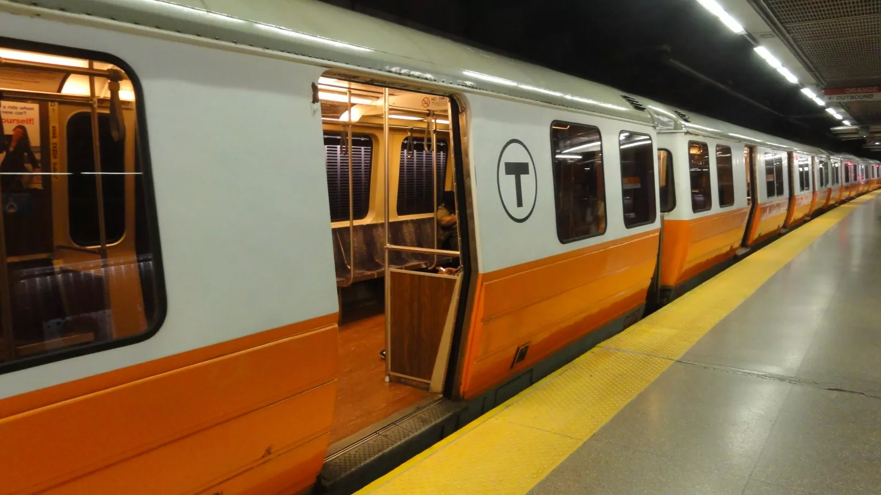
Markov Chain Model of Orange Line Shutdown
Chris Hale
Marley Rywell
Nathan Burwig

Slide 2
MBTA Background
Notes:
Chris

Slide 3
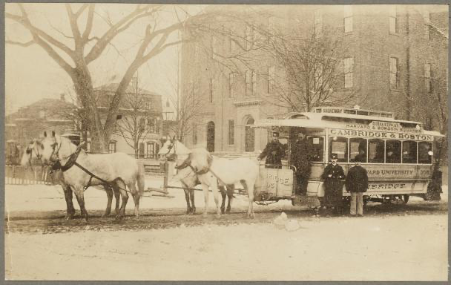
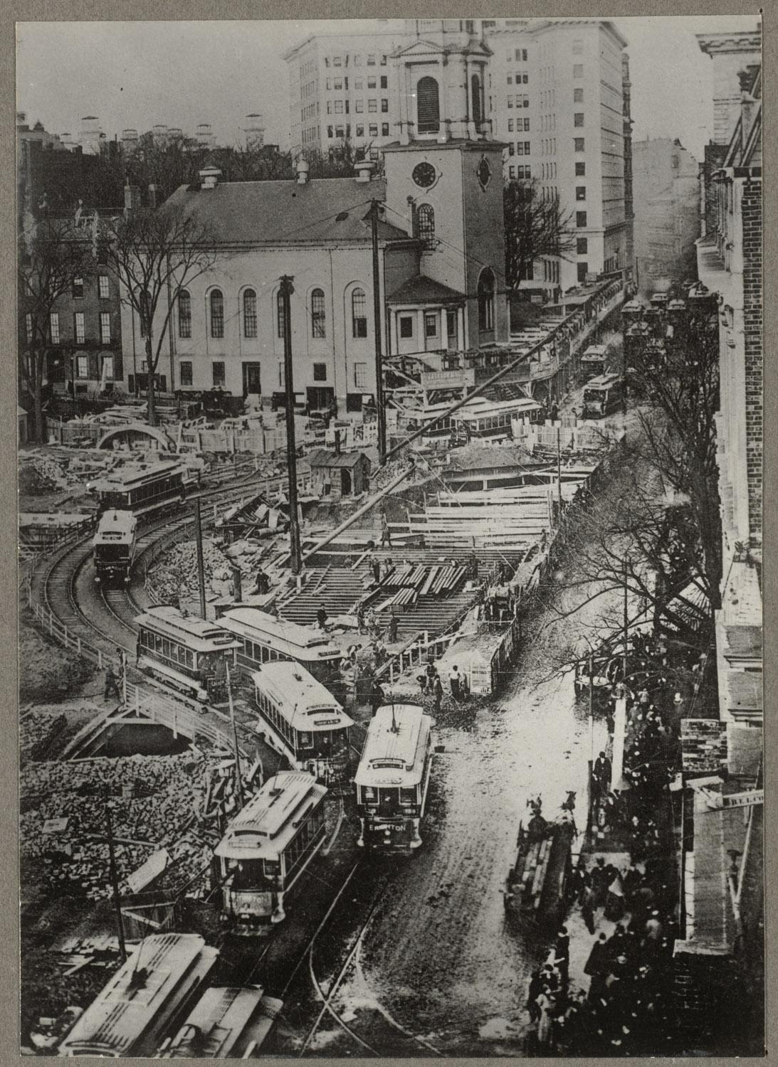
First subway tunnels were built in Boston under the Boston Common
Tremont Street (Gov Center -> Park Street -> Boylston)
Horsecar on rails began in 1856 and ran from Central Square to Bowdoin Square
20 companies became consolidated into West End Street Railway in 1887
First electric streetcar debut in Boston on January 1, 1889 with above ground electrified copper wires
Boston Elevated Railway Company (BERy) created articulated cars
Metropolitan Transit Authority (MTA) expanded the Green Line in 1959
Consolidated all commuter public transportation and Boston city transportation into MBTA
Serves over 200 cities and 1 million daily riders with 100% of electricity produced by renewable sources for the T
West End Street Railway -> BERy -> MTA -> MBTA

Slide 4
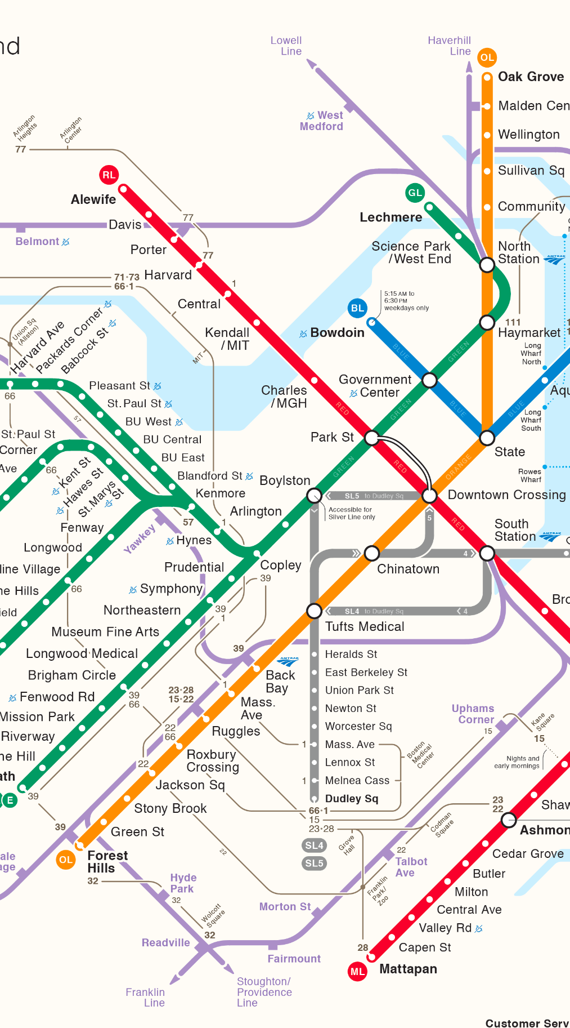
The Orange Line
Forest Hills -> Oak Groves
Opened 1901
Second Highest Ridership
Connects to 20 major stations
Stretches from Malden to Medford to Somerville to Charlestown to Boston

Slide 5
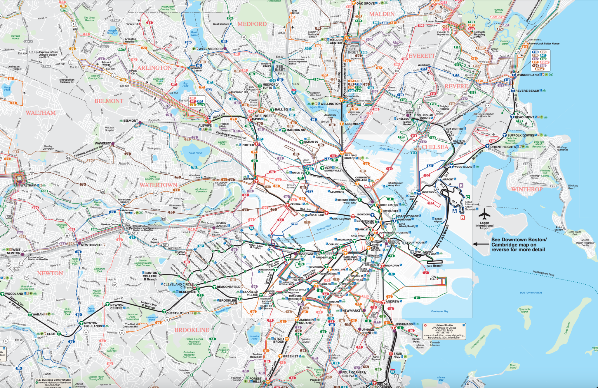

Slide 6
Impact of MBTA Closures
Notes:
Nathan

Slide 7
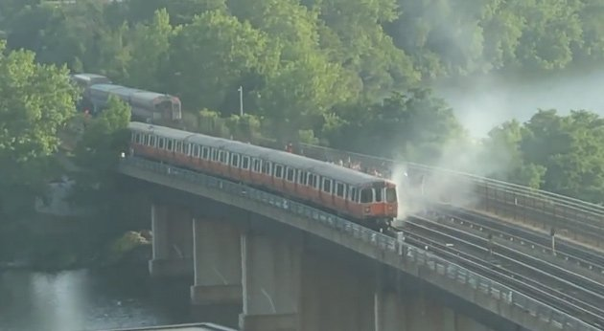
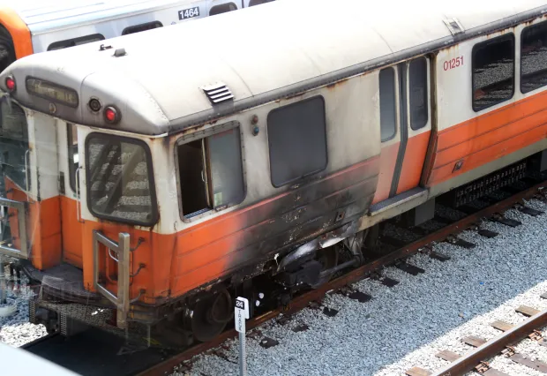

Recently, it was on fire

Slide 8
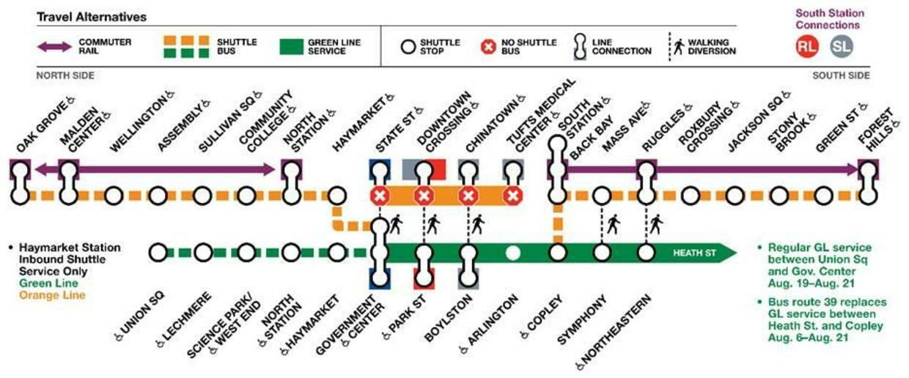
Major Shutdown
Fire led to full orange line shutdown
30 days
Alternate routes opened
Shuttle
Routes closed to other traffic
Green line connections
Walking

Slide 9
Transit Modeling Background
Notes:
Marley

Slide 10
Previous Literature
Integer Programming Yin et al. (2016)
Modeled random unpredictable transit closures with known alternate route times
Markov Chains Sodachi & Valili (2021)
Modeled bus arrival times in Hamburg

Slide 11
Current Source(s)
Modelling Stochastic Transportation Networks with Markov Chains, Klumpenhouwer (2021)
Sets up Mathematical formalism for MC Transit analysis
Developed MCRoute (more on this later)
Utilized MCRoute on three example cases

Slide 12
Data Sources
Notes:
Chris
MBTA Data sources
Show some pictures of code
Talk about data selection process
Why we chose Q3 and other things

Slide 13
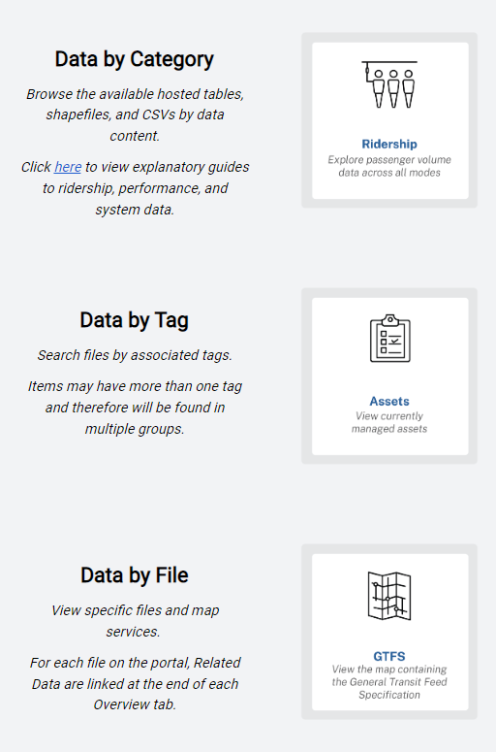
MBTA Database
Wildly complete database
Ridership info
Start stop times
Delays
Dates
Bus routes and T-routes

Slide 14
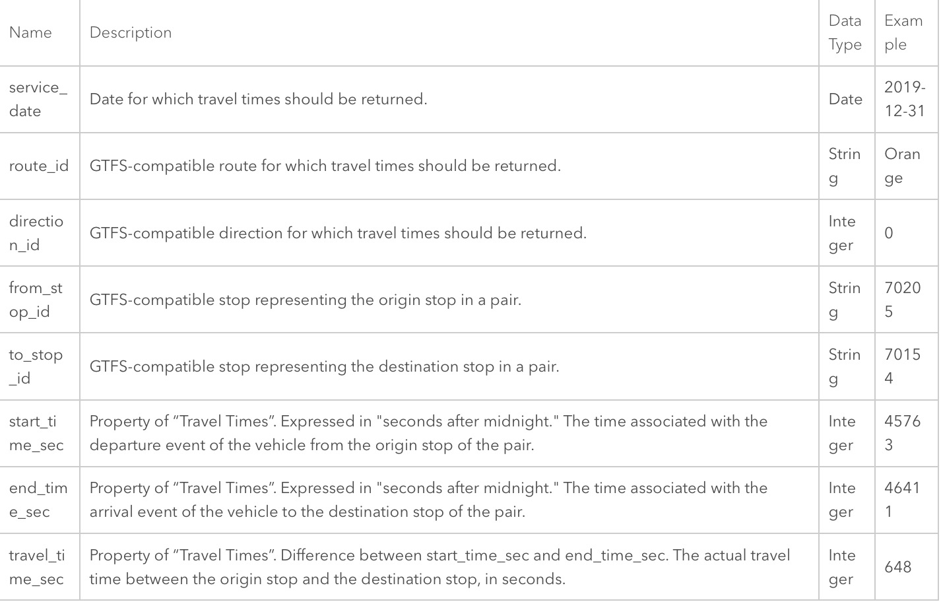
Data Selection
Quarter 3 Data
Orange line before and after shutdown
Good for comparison
Consistency in density of riders during summer period of 7/01/22-9/30/22

Slide 15
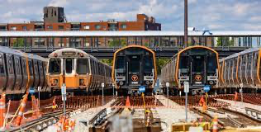
Data Selection Scenarios
No Shutdown of Orange Line
Data from before shutdown - 7/01/22-8/18/22
Data from after shutdown - 9/19/22-9/30/22
Looking at routes that start and end on Orange Line
No impact to other routes as compared to other scenario
During Shutdown of Orange Line
Data from 8/19/22-9/18/22
Further disruptions caused by green line
Looking at alternate bus and train routes
Possibly walking
Orange Line shuttles drove along closed streets and extended bus lanes

Slide 16
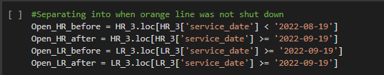
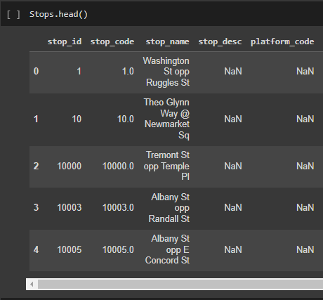
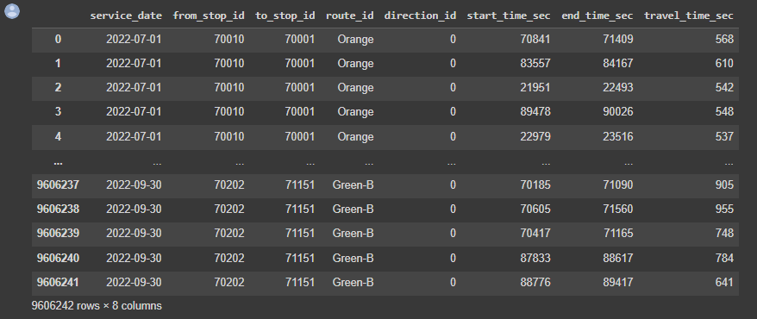
Data Cleaning
Pandas
Stop codes
Total travel time
Separating into Q3
Notes:
Marley

Slide 17
Methods
Notes:
Nathan

Slide 18
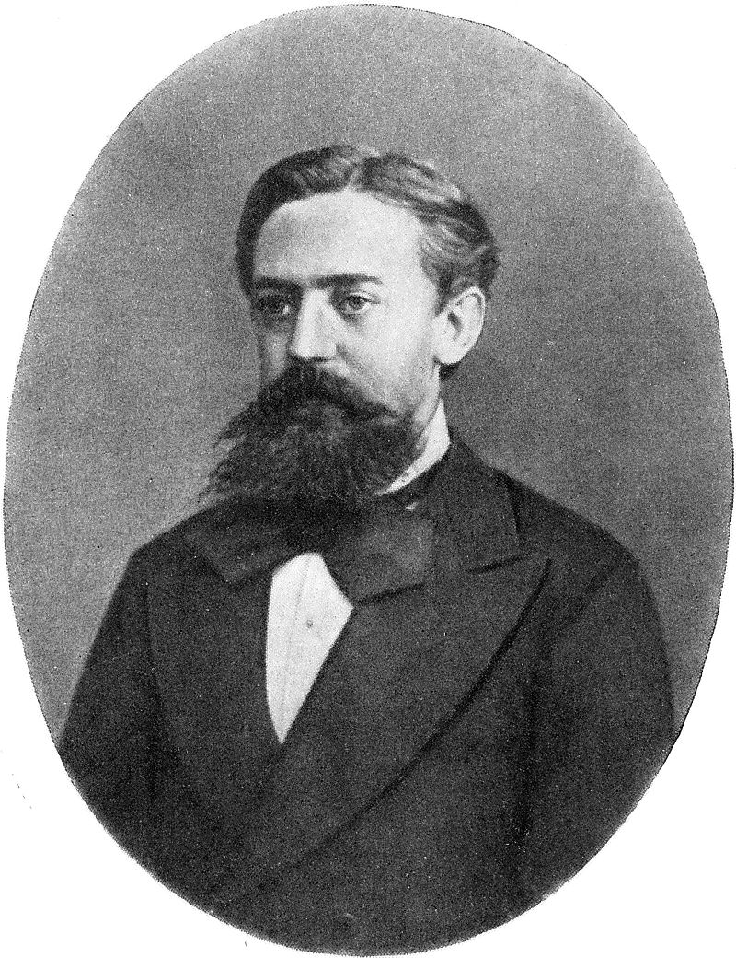
Markov Chains
Why Markov Chains?
Traffic is stochastic
Effects carry out
Delay in one spot delays the rest of the system
Unable to arrive early to final destination
Able to predict approximation of future events
Probability individual arrives on-time to his destination

Slide 19
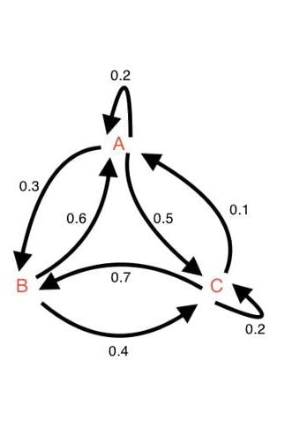
Markov Chains
Outcome depends on random occurrences
Breakdown of Orange Line
Traffic
Longer stopping period at bus and T stops

Slide 20
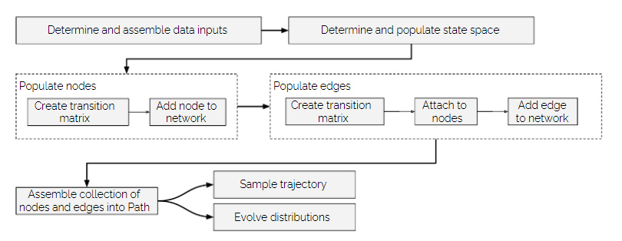
MCRoute
Networks
G=G(N,E,S)
N -> Nodes
E -> Edges
S -> States
State Spaces
Defines bounds of Markov Process
ID and Value pair
Abstractions
“Three minutes late”
“Extremely late”

Slide 21
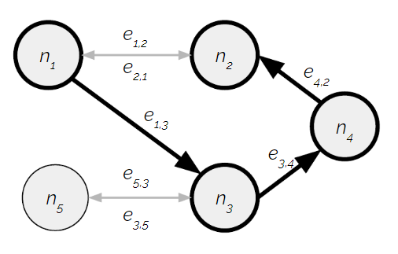
MCRoute
Time Evolution
Time steps given by travel through a node or edge
Not always evenly spaced
Paths
P = {n1, e12, n3, e34, …}
How we characterize routes in MBTA
Transition Probability Matrices
Each node has transition probability matrix
Stochastic
How likely object in state i moves to state j
Notes:
A state space consists of an ordered sequence (lists) of values and labels which represent the various possible states an object can take in a MCRoute network. These states can be relatively arbitrary, though they typically represent some sort of value-associated state such as schedule delay or travel time.
Values associated with states are considered the lower bound of a given state. This arbitrary decision is required to support the construciton of transition probability matrices from probability distributions.
A network consists of a set of nodes, edges, and a state space under which to perform Markov-chain related activities. Nodes must be instantiated first, and subsequently connected by edges.

Slide 22
Small Scale Sample
Notes:
Marley

Slide 23
Consider
The tradeoff between taking a potentially shorter route with a higher chance for delay
or
Taking a longer route with a lower chance for delay

Slide 24
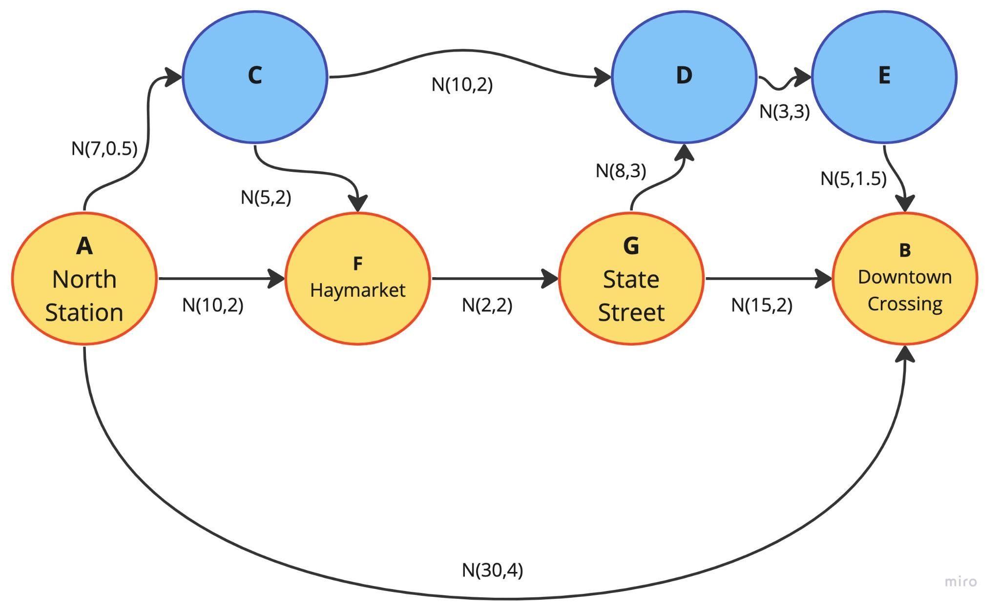
The Setup
4 stations on the orange line
You can either
Take the replacement busses to each original stop (orange)
Take replacement busses with additional bus routes (blue)
Walk the entire way
Each path has an average travel time and a standard deviation of travel time

Slide 25
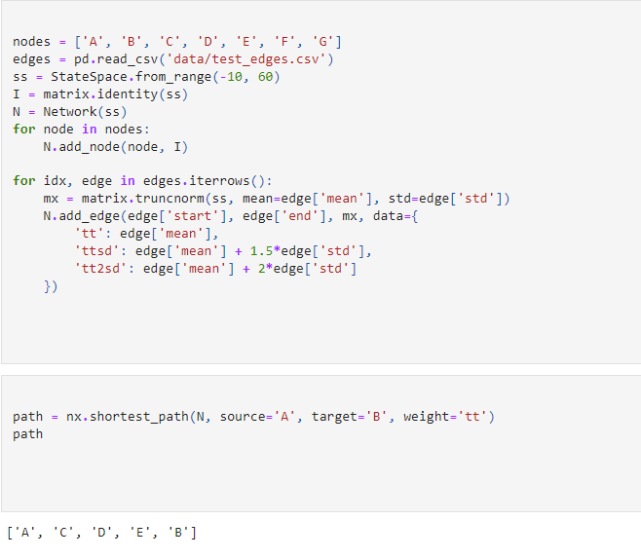
Path Calculations
Disclaimer: sample code (not ours)
Example
Loading nodes
Loading edges from a csv
Creating state space
Edge weights
tt -> Total time
Calculate shortest path given mean and stdev
Use to calculate probability of delay and severity
Establish margin of error
Probability you arrive within margin of error
Notes:
Nathan

Slide 26
Results
If you want to be 95% confident you will arrive in the time you expect the route to take, you should walk
If you are willing to only be 87% confident you will arrive in the time you expect the route to take, you take the blue bus route
If you just want to take the shortest route (on average), you should take the orange line replacement busses

Slide 27
Problems

Slide 28
How to handle/predict a bus being full?
How should we calculate the probability that you are on-time while the orange line is shut down as compared to your normal commute while the orange line is open?
Notes:
Chris
Idea of not being able to make up time may be asked during Markov Chain part, we should throw this back at the class. It might be asked about how you arrive at one bus stop later than usual, but still catch the same bus.

